Slide 1


POKEMON BATTLES
Viano Arcery, Sean Block, Vishal Hada, Tobey Tan, Kyle Qin

Slide 2

Problem
Progress in a game with small time commitment
Don't want to play the entire Pokemon game
Only interested in the battle aspect of Pokemon
Want quick, easy, and fun battles with friends
Not platform specific
Notes:
Pokemon games are long and encourage long playtime to complete story and explore
Many players can’t commit that much time
Many mainly love the battling, would love to do that in free time
Don't want to play the entire Pokemon game
Will not feature story or exploration
- web application, don’t need a specific console or online subscription
Viano

Slide 3

Project Summary
Spinoff of traditional pokemon games
No roleplay, only battles
Progression through experience
Notes:
Tobey
Multiplayer Pokemon battle game
Battle other online users
Level up your Pokemon
Evolve your Pokemon
Unlock new Pokemon
Choose from your Pokemon collection for battle

Slide 4
Functional Requirements
Pokemon Battles Game with Multiplayer (1v1) Support
Pokemon Level-Up/Evolution System
In-Game Currency and New Pokemon Unlock
Cross-Platform Support (PC, Mobile)
User Progress Storage
REST API
Notes:
1v1, up to 6 pokemon per battle, Swap Pokemon, No Items
Evolutions/New Moves
Unlock New Pokemon

Slide 5
Non-Functional Requirements
Classic Pokemon Game User Interface
24/7 Accessibility
Responsiveness
Extensibility
Open Source
Testability
Notes:
As for nonfunctional requirements, our team decided to follow the classic set of pokemon game ui, in addition, cross platform support

Slide 6
Users
Any pokemon players that want to play pokemon with other players since Pokemon battles allow for multiplayer gaming.
Anyone in general who plays online games and wants to be able to play a competitive multiplayer game with pokemon characters.
Notes:
Vishal

Slide 7
Stakeholders
Dr. Callahan, Vandita Patidar
Teaching Staff of Web Science Systems Development.
Viano Arcery, Sean Block, Vishal Hada, Tobey Tan, Kyle Qin
Developers and Designers of Pokemon Battles
Gamers and Pokemon Fans
Main User Group of Pokemon Battles
Game Development Community
Potential Future Developers of Pokemon Battles
Media
Sources of Commentary and Critique
Notes:
Vishal

Slide 8



Technology Stack

Slide 9
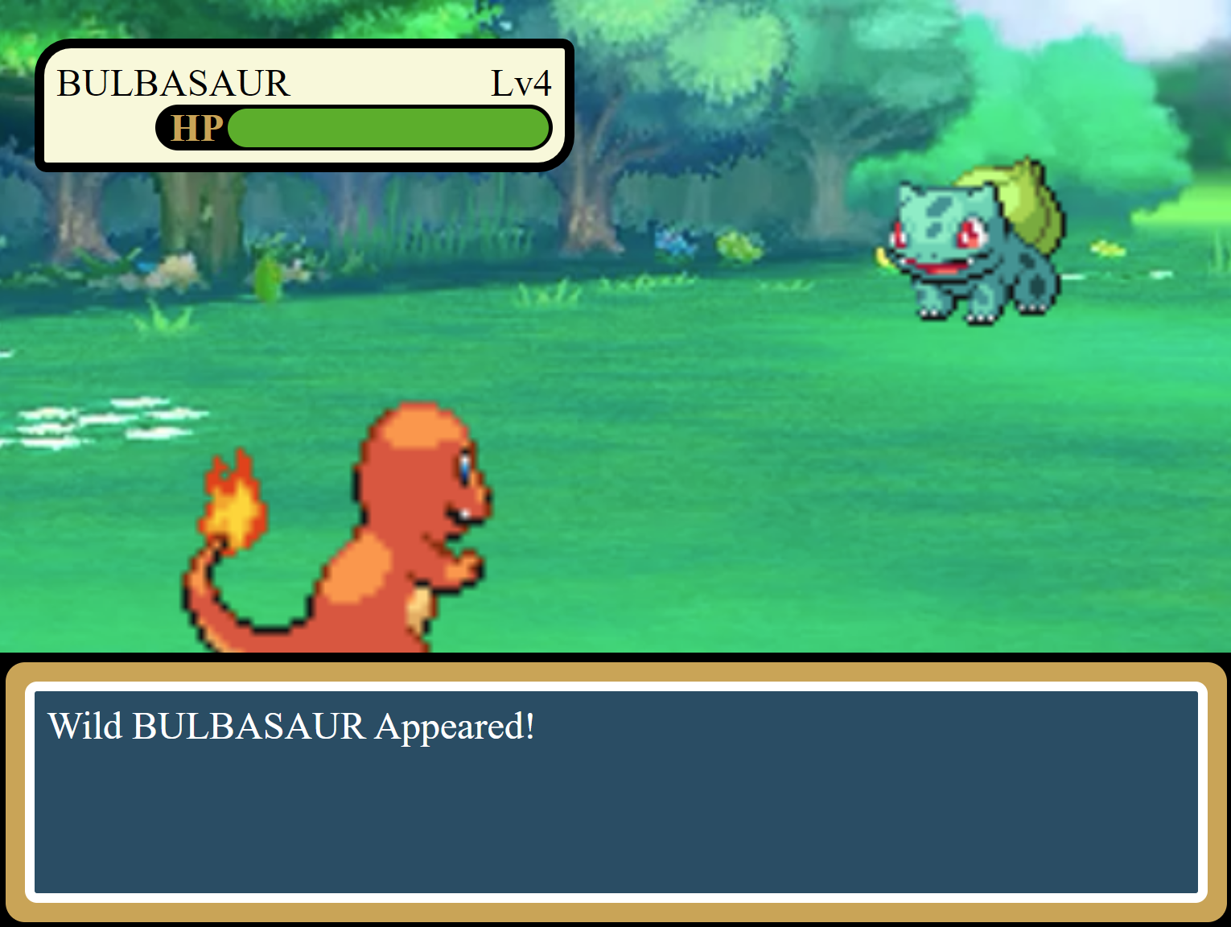
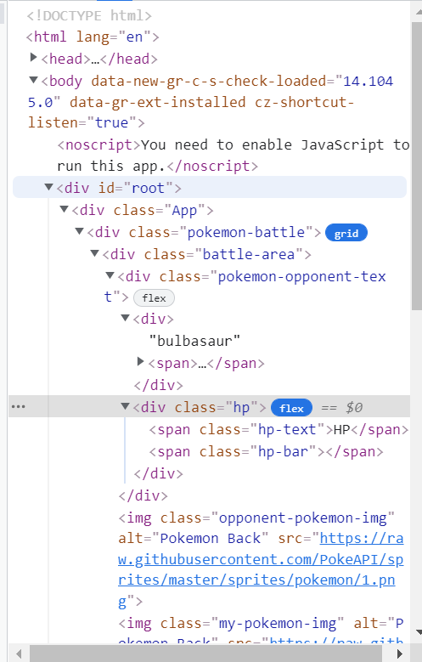
Concept

Slide 10


Thank You!
Any questions?

